Slide 1
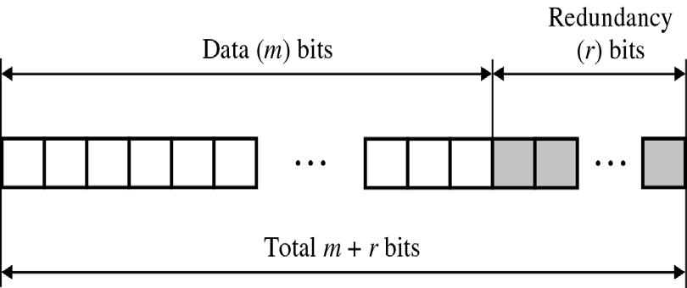
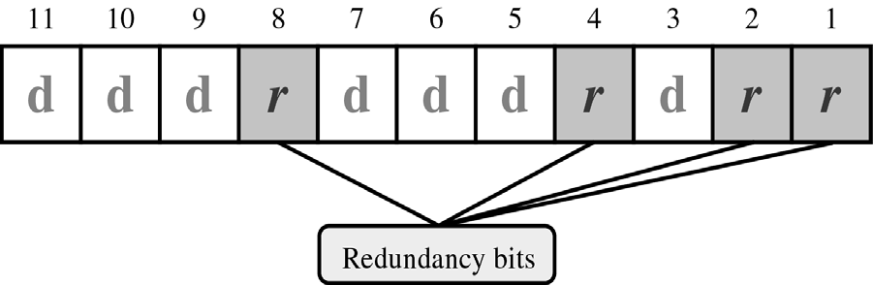
CS601-Data Communication
VU
LECTURE #36
Hamming Code
Redundancy Bits (r)
r must be able to indicate at least m+r+1 states
m+r+1 states must be discoverable by r bits
Therefore, 2r ≥ m+r+1
o If m=7, r=4 as 24 ≥ 7+4+1
Hamming Code
Each r bit is the VRC bit for one combination of data bits
r1(r2) bit is calculated using all bit positions whose binary representation includes a 1 in the first(second) position, and so on

Slide 2
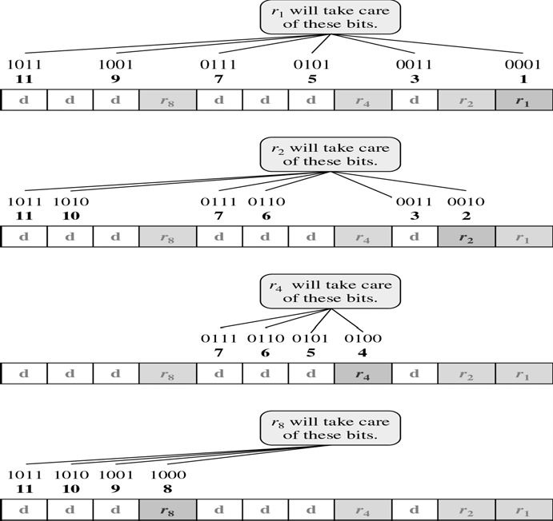
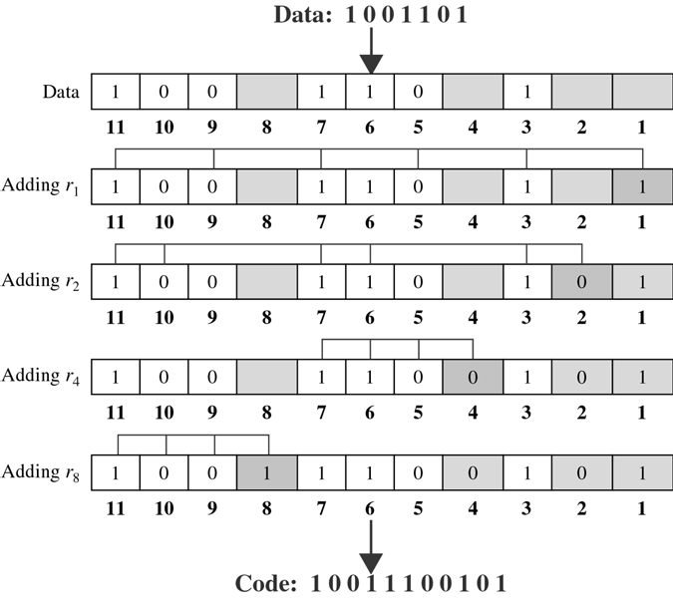
CS601-Data Communication
VU

Slide 3
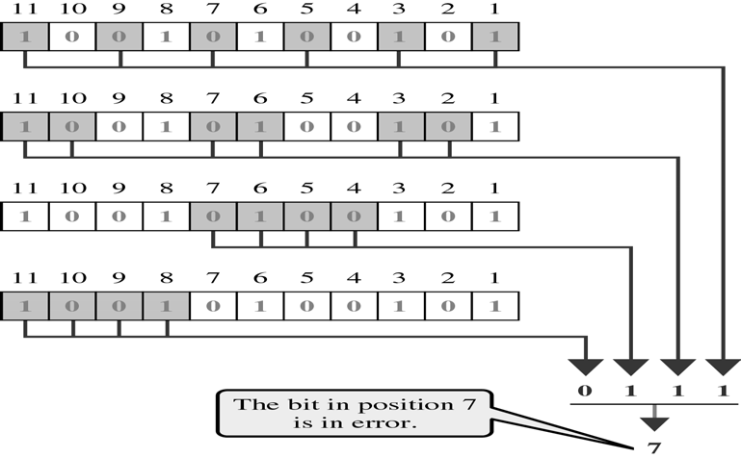
CS601-Data Communication
VU
Data Link Layer
Introduction
Unless accurately received by a 2nd device, a signal TX over a wire is a waste of electricity
With TX alone, we can put a signal to the line, but we have
–no way of controlling which of several devices attached to that line will receive it
–no way of knowing if the intended receiver is ready and able to receive it
–No way of keeping a second device from TX at the same time
Communication requires at least 2 devices working together:
–Sender
–Receiver
Even such a basic arrangement requires great deal of coordination
For Example, in Half Duplex TX, it is essential that only one device TX at a time
If both device TX, the signals will collide leaving nothing on the line but Noise
The coordination of half-duplex TX is a part of a procedure called Line Discipline, which is one of the functions included in the second layer of OSI Model, the data link layer
In addition to Line Discipline, the most important functions in the data link layer are Flow Control and Error Control
Collectively these functions are called Data Link Control

Slide 4
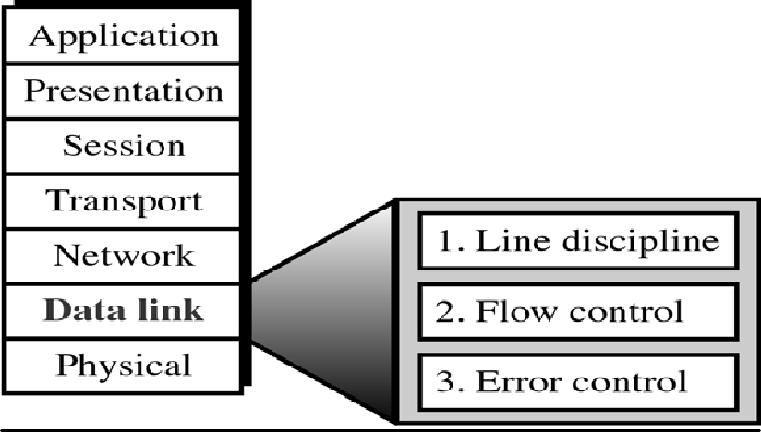
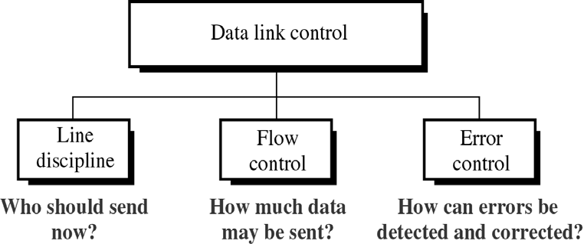
CS601-Data Communication
VU
Data Link Layer & its Functions
Data Link Control
Line Discipline:
– Coordinates the link systems, which device can send and when it can send?
Flow Control:
–The amount of data that can be sent before the receiving acknowledgement
–It also provides the receiver’s acknowledgement for frames received intact and so is linked to error control
Error Control:
–Means Error detection and Correction
–It allows the receiver to inform the sender of any frames lost or damaged in TX and coordinates Retransmission of those frames by the sender
Line Discipline
How efficient the system is, no device in it should be allowed to transmit until that device has the evidence that the intended receiver is:
–able to receive
–is prepared to accept the TX
What if the Rx device does not expect a transmission or is busy

Slide 5
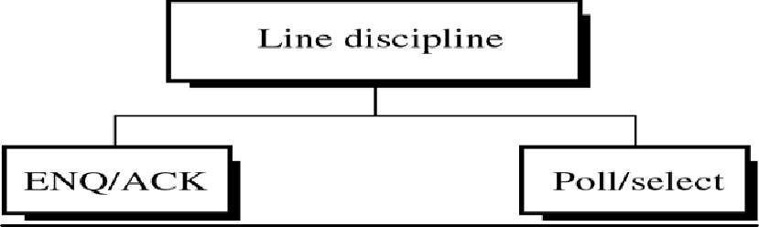
CS601-Data Communication VU
With no way of determining the status of the intended receiver, the transmitting device may waste its time sending data to a non-functioning receiver
The Line Discipline functions of the data link layer oversee:
– the establishment of links and
–The right of a particular device to transmit at a given time
Ways to do Line Discipline
Line Discipline is done in 2 ways:
*Enquiry / Acknowledgement (ENQ/ACK)
–Used in Peer-to-Peer Communication
*Poll / Select
–Primary-Secondary communication
Summary
Hamming Code
Data Link Control
Line Discipline
ENQ/ACK
POLL/SELECT
Flow Control
Reading Sections
Section 9.7, 10.1 “Data Communications and Networking” 4th Edition by Behrouz A. Forouzan

Slide 6
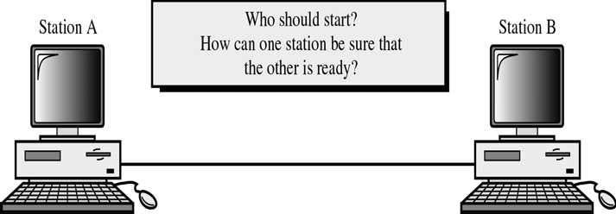
CS601-Data Communication
VU
LECTURE #37
Line Discipline
Enquiry / Acknowledgement (ENQ/ACK)
Used primarily in systems where there is no question of wrong receiver getting the transmission
In other words when there is a Dedicated Link b/w the two devices so that the only device that can receive data is the intended one
Enquiry / Acknowledgement (ENQ/ACK)
ENQ/ACK coordinates who may start a transmission and whether or not the intended recipient is ready and enabled
Using ENQ/ACK, a session can be initiated by either station on a link as long as both are of equal rank- a printer for example cannot initiate communication with a CPU
Enquiry / Acknowledgement (ENQ/ACK)
In both half duplex and full duplex TX, the initiating device establishes the session
In half-duplex, the initiator then sends its data while the responder waits
The respondent may take over the link when the initiator is finished or has requested a response
In full duplex, both the devices can TX simultaneously once the link has been established
How It Works?
The receiver must answer either with an acknowledgement (ACK) frame if it is ready to receive or with a negative acknowledgement ( NAK), if it is not
By requiring a response, even if the answer is negative, the initiator knows that his enquiry was in fact received even if the receiver is currently unable to receive
If neither an ACK or a NAK is received within a specified time limit, the initiator assumes that an ENQ frame was lost in transit, it disconnects and sends a replacement
An initiating system ordinarily makes 3 such attempts before giving up
If the response to the ENQ is negative for 3 attempts, the initiator disconnects and begins the process again at another time
*If the response is positive the initiator is free to send its data

Slide 7
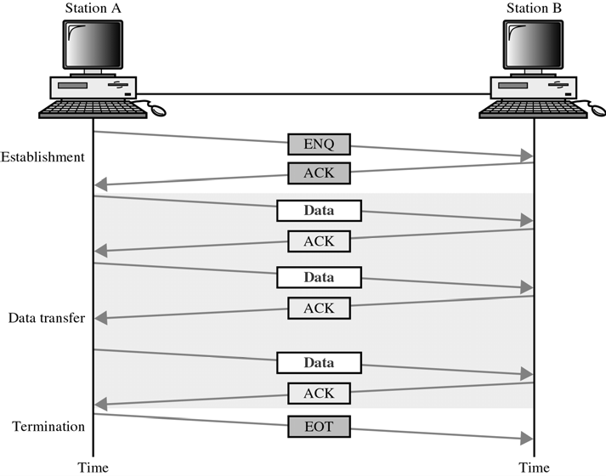
CS601-Data Communication
VU
The initiator first transmits a frame called an enquiry (ENQ) asking if the receiver is available to receive data
Once all of its data have been transmitted, the sending system finishes with an End of Transmission (EOT) frame
Poll / Select
Primary-Secondary communication
This method works with topologies where one device is designed as a Primary station and the other devices are Secondary stations
Multipoint systems must coordinate several nodes, not just two
The questions are not only Are you Ready? But also Which of the device has the right to use the channel
Whenever a multipoint link consists of a primary device and multiple secondary devices using a single TX line , all exchanges must be made through the primary device even when the ultimate destination is a secondary device
The primary device controls the link and the secondary device follow sits instruction
It is up to the primary to determine which device is allowed to use the channel ata given time
The primary therefore is always the initiator of the a session
*If the primary wants to receive data, it asks the second-arise if they have anything to send, This is called POLLING
*If the primary wants to send data, it tells the target secondary to get ready to receive,
This function is called SELECTING

Slide 8
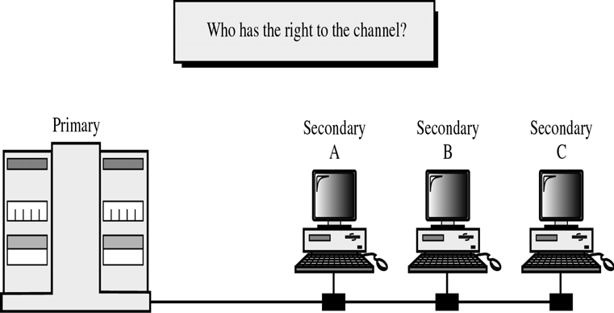
CS601-Data Communication
VU
ADDRESSING
For point-to-point configuration, there is no need for addressing
Any TX put onto the link by one device can be intended only for the other
For the primary device in a a multipoint topology to be able to identify and communicate with a specific secondary device, there must be some addressing convention
For this reason, every device on the link has an address that can be used for identification
In any transmission, this address will appear in a specified portion of each frame, called the Address Field or Header depending upon the protocol
If the TX comes from a secondary device, the address indicates the originator of the data
SELECT
The select mode is used whenever the primary device has something to send
Primary control the link and if primary is not sending or receiving data, it knows that the link is available
If it has something to send, it sends it
As a frame makes its way to the intended device, each of the other devices check the address field
Only when the device recognizes its own address, does it open the frame and read the data
In case of a SEL frame, the enclosed data consists of an alert that data is forthcoming
What it does not know, however is if the target device it ready to receive (ON)
So the primary must alert the secondary to the upcoming TX and wait for an acknowledgement of the secondary ready status
Primary send a SEL frame, one field of which includes the address of the intended RX
If the secondary is awake and running, it returns an ACK frame to the primary
The primary then sends one or more data frames , each addressed to the intended secondary
190

Slide 9
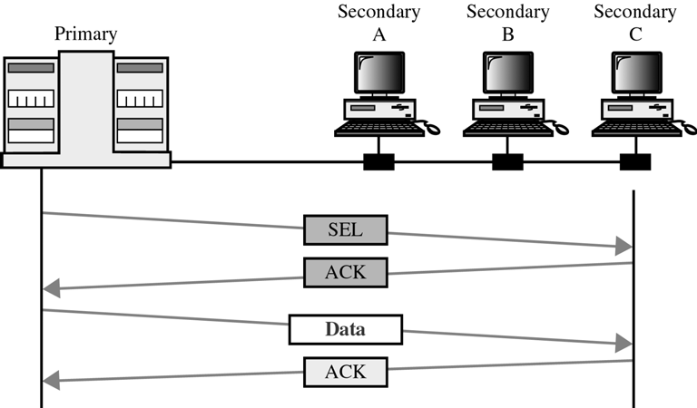
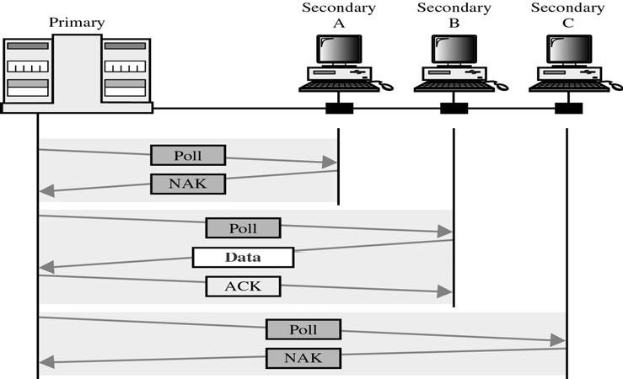
CS601-Data Communication
VU
POLL
Used by the primary device to receive transmissions from the secondary devices
The secondaries are not allowed to TX data until asked
By keeping control with the primary, the multipoint system guarantees that only one TX can occur at a time
When the primary is ready to receive, data , it must ask (POLL) each device in turn if it has anything to send
When the first secondary is approached, it responds either with a NAK frame if it has nothing to send or with data if it does
If the response is negative, primary then polls the next secondary
When the primary has received data, it acknowledges by sending an ACK
*Two possibilities for termination:
–A secondary sends all its data and finishes with EOT frame
–Primary says “ Time is Up”

Slide 10
CS601-Data Communication
VU
Flow Control -Definition
*2nd aspect of data link control is Flow Control
*In most protocols, flow control is a set of procedures that tells the sender how much data it can transmit before it must wait for an ACK from the receiver
*The flow of data must not be allowed to overwhelm the receiver
Summary
Line Discipline
-ENQ/ACK
-POLL/SELECT
Flow Control
Stop-and-Wait
Sliding Window
Reading Sections
Section 10.1,10.2 “Data Communications and Networking” 4th Edition by Behrouz
A. Forouzan

Slide 11
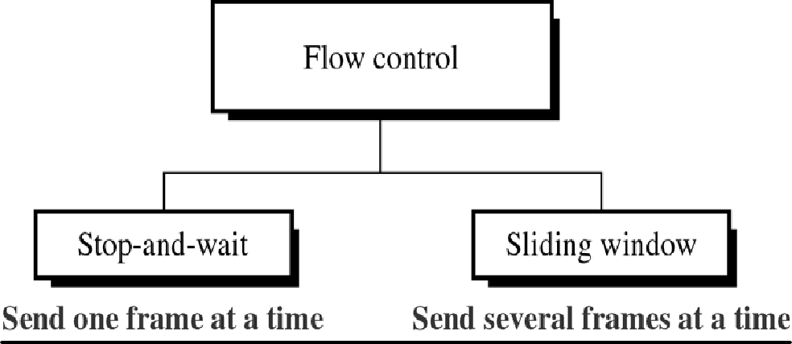
CS601-Data Communication
VU
LECTURE #38
Flow Control- Explanation
Any receiving device has a limited speed at which it can process incoming data and a limited amount of memory in which to store incoming data
The receiving device must be able to inform the sending device before those limits are reached and to request that the TX device send fewer frames or stop temporarily
Flow Control-Buffer
Incoming data must be processed and checked before it can be used
The rate of such processing is often slower than the rate of TX
So, each receiving device has a block of memory called BUFFER, reserved for storing incoming data until it is processed
If the buffer begins to fill up, the receiver must be able to tell the sender to halt the TX until it is once again able to receive
Methods for Flow Control
Two methods have been developed to control the flow of data across communication links :
Stop and Wait
Sliding Window
Stop and Wait
In this method, the sender waits for an ACK after every frame it sends

Slide 12
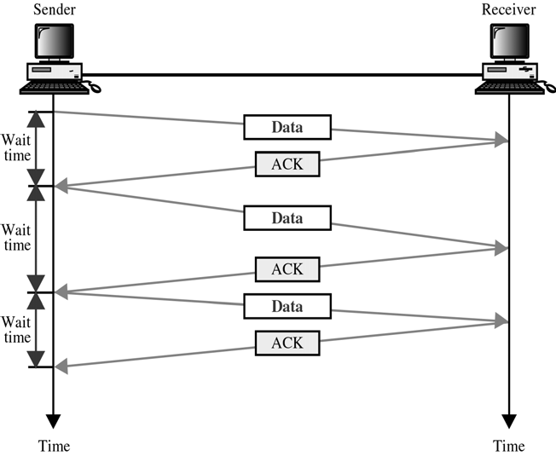
CS601-Data Communication
VU
Only when an ACK has been received, is the next frame sent
This process of alternately sending and waiting repeats until the sender transmits an EOT frame
Example: Officer giving dictation to the Typist, He says a word, typist says OK, he says the next word, typist says OK and so on
Advantages of Stop and Wait
*SIMPLICITY
–Each frame is checked and acknowledged before the next frame is sent
Disadvantages of Stop and Wait
*INEFFICIENT ( Slow)
Each frame must travel all the way to the receiver and an ACK must travel all the way back before the next frame can be sent
If the distance b/w devices is long, the time spent waiting for ACKs between each frame can be significantly long
Sliding Window
In this method, sender can transmit several frames before needing an ACK
Frames can be sent one right after another meaning link can carry several frames at once and its capacity can be used efficiently
The receiver uses a single ACK to confirm the receipt of multiple data frames
Sliding Window refers to imaginary boxes at both the sender and the receiver
This window can hold frames at either end and provides the upper limit on the number of frames that can be sent before requiring an ACK
Frames may be ACK at any point w/o waiting for the window to fill up and may be TX as long as the window is not yet Full
To keep track of which frames have been transmitted and which received, sliding window introduces an identification scheme based on the size of the window
The frames are numbered modulo-n means from 0 to n-1
o If n=8, frames are numbered 0,1,2,3,4,5,6,7,0,1,2,3,4,5,6,7,0,….

Slide 13
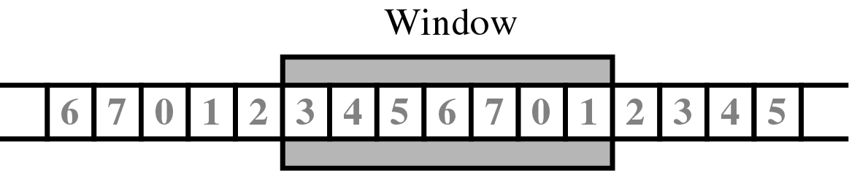
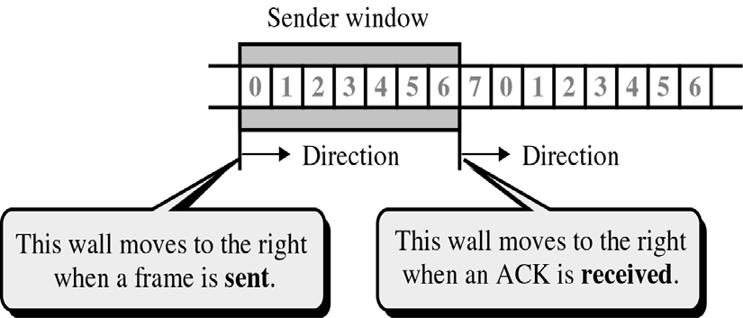
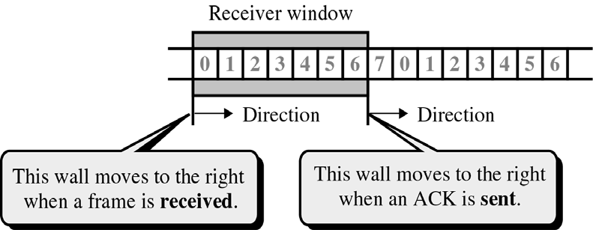
CS601-Data Communication
VU
o When the receiver sends the ACK, it includes the number of the next frame it expects to receive
o
*For example, to ACK the receipt of a string of frames ending in frame 4, the receiver sends an ACK with number 5
*The window can hold n-1 frames at either end, therefore a max of n-1
frames may be sent before an ACK is required
*At the beginning of a TX, sender’s window contains n-1 frames
*As frames are sent out, the left boundary of window moves inward, shrinking the size of the window
*When an ACK is received, the window expands to allow in a number of
new frames equal to the number of frames acknowledged by that ACK
*At the beginning of TX, the receiver window contains n-1 spaces for frames
*As new frames come in, the size of the receiver window shrinks

Slide 14
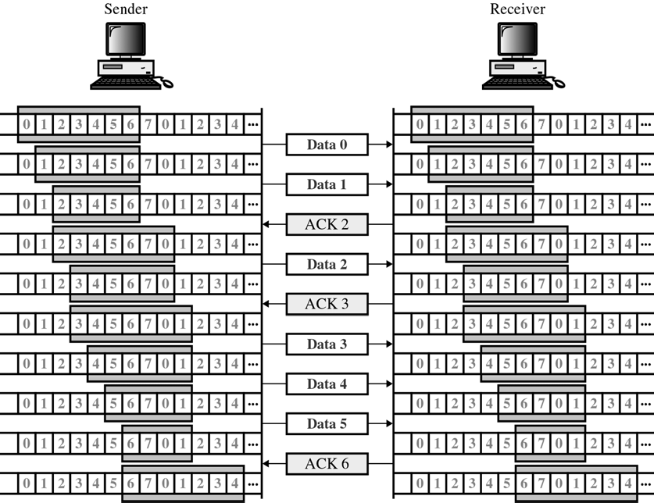
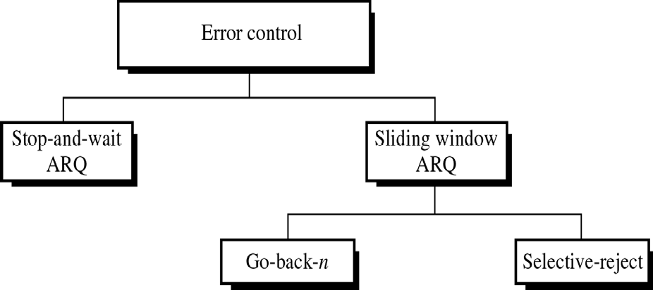
CS601-Data Communication
VU
*The receiver window therefore does not show the frames that are received but the frames that may still be received before an ACK is sent
ERROR CONTROL
Refers primarily to error detection and correction
*AUTOMATIC REPEAT REQUEST (ARQ)
Error control in data link layer is implemented simply:
–Anytime
an error is detected in an exchange, a negative
acknowledgement (NAK) is returned and the specified frames are retransmitted
Categories of Error Control

Slide 15
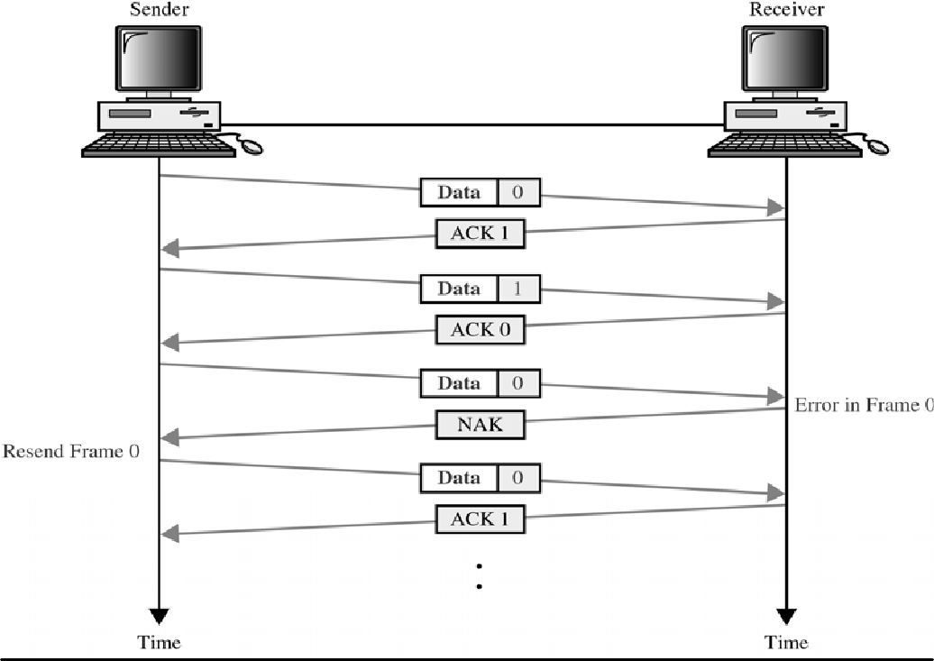
CS601-Data Communication
VU
Stop and Wait ARQ
It is a form of stop-and-wait flow control extended to include retransmission of data in case of Lost or Damaged frames
For retransmission to work, 4 features are added to the basic flow control mechanism
Sending device keeps a copy of the last frame transmitted until it receives the ACK for that frame
Both data and ACK frames are numbered 0 and 1 alternately
A data 0 frame is acknowledged by a ACK 1 frame indicating that the receiver has received data 0 and is now expecting data 1
Sending device keeps a copy of the last frame transmitted until it receives the ACK for that frame
Both data and ACK frames are numbered 0 and 1 alternately
–A data 0 frame is acknowledged by a ACK 1 frame indicating that the receiver has received data 0 and is now expecting data 1
If an error is discovered in a data frame an NAK frame is returned NAK frames which are not sent tell the sender to retransmit the last frame
The sending device is equipped with Timer. If an expected ACK is not received within an allotted time period, the sender assumes that the last frame sent is lost and resends the frame
Damaged Frame

Slide 16
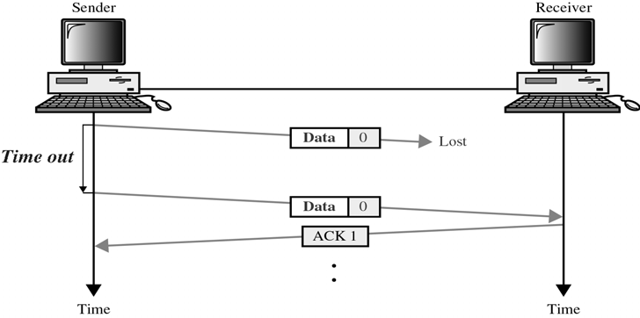
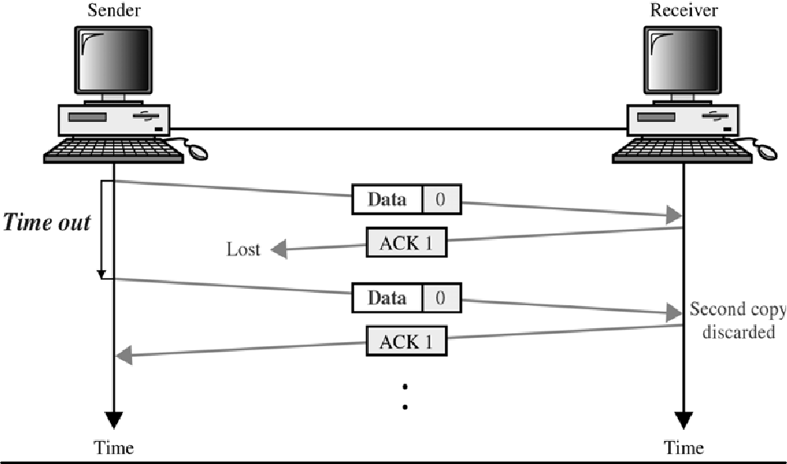
CS601-Data Communication
VU
Lost Frame
Any of the 3 frame types can be lost in transit:
Lost Data Frame
Lost ACK Frame
Lost NAK Frame
Lost ACK, NAK Frame
*
Summary
Flow Control
-Stop-and-Wait-
-Sliding Window
Error Control
Reading Sections
Section 10.2, 10.3 “Data Communications and Networking” 4th Edition by Behrouz A. Forouzan

Slide 17
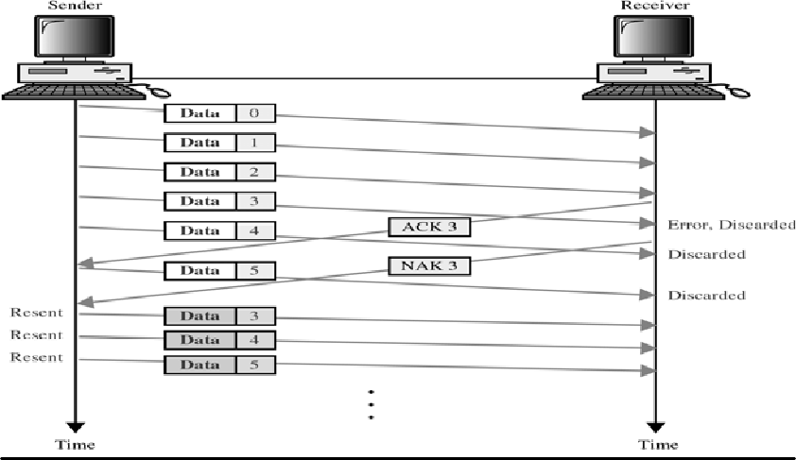
CS601-Data Communication
VU
LECTURE #39
SLIDING WINDOW ARQ
Among several popular mechanisms for error control two protocols are important:
Go-back-n ARQ
Selective Reject ARQ
Three features are added to sliding window flow control to allow for the retransmission of the lost or the damaged frames:
The sending device keeps copies of the transmitted frames until all of them have been acknowledged
In addition to ACK frames, receiver also has the option of NAK frames, if data has been received damaged
Because sliding window is a continuous TX mechanism, both ACK and NAK frames must be numbered for identification
ACK frames carry the number of the next frame expected
ACK 5 tells sender that all frames up to frame 5 are received
NAK frames carry the number of the damaged frame itself
If data frames 4 and 5 are damaged, NAK 4 and NAK 5 must be sent
Like sender in stop-and wait ARQ, the sliding window ARQ is also equipped with a timer in the sender to deal with lost ACKs
Go Back n ARQ
In Go Back n ARQ, if one frame is lost or damaged, all frames sent since last frame acknowledged are retransmitted
Go Back n- Damaged Frame
Go Back n- Lost Data Frame
o Sliding window requires that data frames be transmitted sequentially

Slide 18
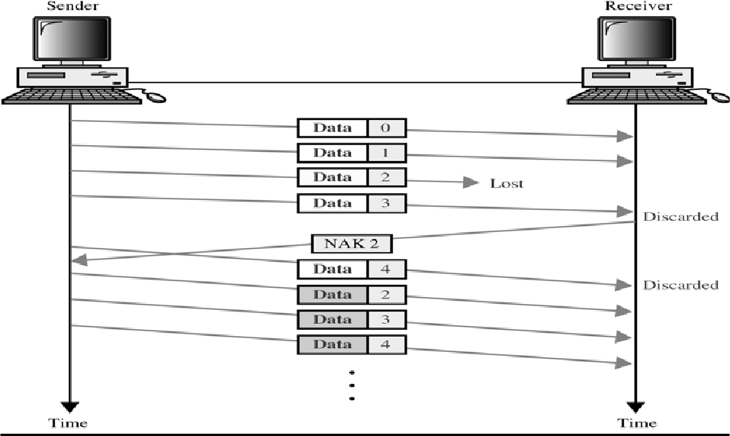
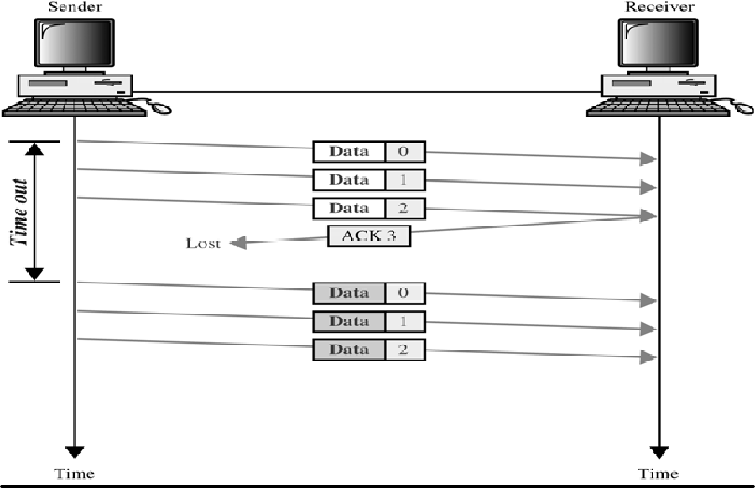
CS601-Data Communication
VU
o If one or more frames are so noise corrupted that they become lost in transit, the next frame to arrive at the receiver will be out of sequence
Go Back n- Lost ACK
When the window capacity is reached and all frames allowed have been sent, the sender starts a Timer
If an ACK is not received before that Timer expires, sender retransmits all the frames since the last ACK
Selective Reject ARQ
o In selective-reject ARQ, only the specific retransmitted
damaged or lost frame is
o If a frame is corrupted in transit, a NAK is returned and the frame is resent out of sequence
200

Slide 19
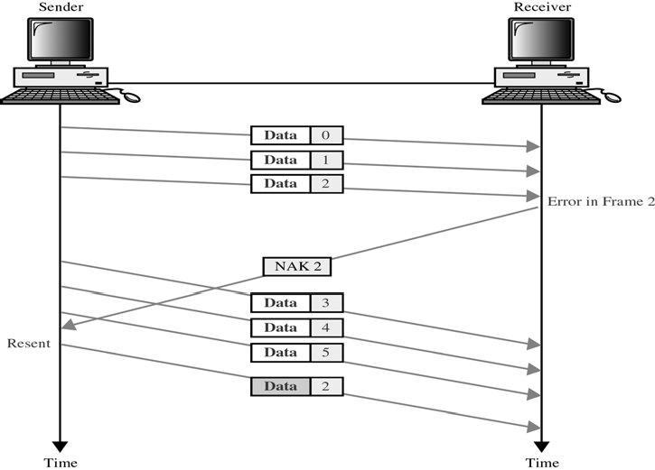
CS601-Data Communication
VU
The Rx device must be able to sort frames and insert the retransmitted frame into the proper place
The selective reject ARQ differs from Go Back n in the following ways:
The Rx device must contain sorting logic to enable it to reorder frames received out of sequence
Sending device must contain a searching mechanism that allows it to find and select only the requested frame for retransmission
Selective Reject ARQ
A buffer in the receiver must keep all previously received frames on hold until all retransmissions have been stored
To avoid selectivity, ACK number, like NAK numbers must refer to frame received instead of next expected frame
A smaller window size is required because of this added complexity
Selective Reject ARQ-Lost Frame
Lost ACK/NAK are treated exactly in the same way as by Go Back n
Selective Reject ARQ vs Go Back n
o Although retransmitting only specific damaged or lost frames may seems more efficient than resending all the frames

Slide 20
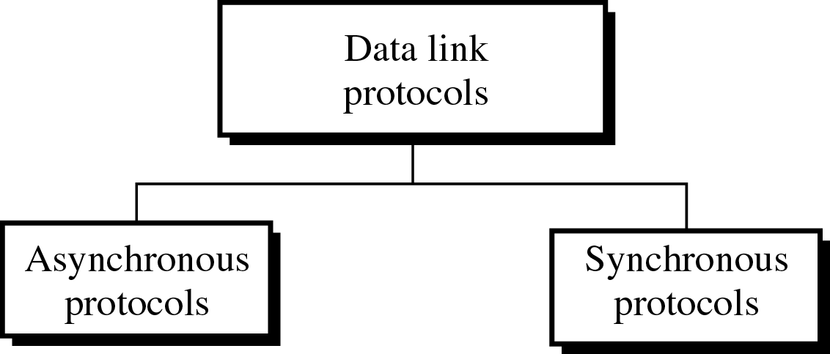
CS601-Data Communication VU
Because of the complexity of sorting and storage required by the receiver and extra logic needed by sender to select specific frames for retransmission, selective reject ARQ is EXPENSIVE and not often used
Selective reject gives better performance but in practice it is usually it is discarded in favor of go-back-n for simplicity of implementation
Protocols
Protocol: Set of rules or conventions for executing a particular task
Protocol in Data Comm.: Set of rules or specifications used to implement one or more layers of the OSI Model
Example: EIA 232-D interface is a protocol used at the physical layer in the OSI Model Protocols
Data Link Protocols: Set of specifications used to implement the data link layer Data link protocols contain rules for:
–Line Discipline
–Flow Control
–Error Control
Categories of Data Link Protocols
Data link protocols can be divided into two sub-groups:
Asynchronous Protocols: Treat each character in a Bit stream independently
Synchronous Protocols: Take the whole bit stream and chop it into characters of equal Size
Asynchronous Protocols
Employed mainly in Modems
Inherent Slowness is a disadvantage: Requires addition of start and stop bits and extended spaces b/w frames, so these are mainly replaced with High-speed synchronous mechanisms

Slide 21
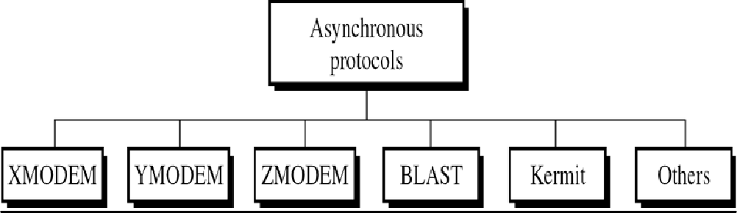
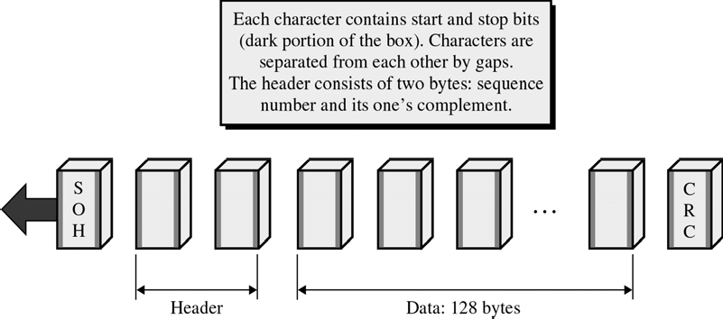
CS601-Data Communication
VU
Not Complex and Inexpensive to Implement
Transmission does not require timing coordination; Timing is done by using extra bits
Different Asynchronous Protocols
A variety of Asynchronous protocols have been developed We will discuss some of the important ones
XMODEM
In 1979 Ward Christiansen designed a File transfer protocol for Telephone-line communication b/w PCs called XMODEM
Half Duplex and Stop-and-Wait ARQ protocol
XMODEM
The first field is a One Byte start of header (SOH) field
The second field is a two-byte Header.
–The first header byte , the Sequence number carries the Frame number
–The second header byte is used to check the validity of the sequence number
The fixed data field holds 128 bytes of data
The last field CRC checks for errors in the data field only
Transmission in XMODEM
TX begins with sending of a NAK frame from the receiver to the sender
Each time, the sender sends a frame, it must wait for an ACK before sending next frame

Slide 22
CS601-Data Communication VU
If NAK is received instead of ACK, the last frame is sent again
A frame is also resent if no response arrives from a receiver after a fixed time period
A sender can also receive cancel (CAN) to abort TX
Control Frames in XMODEM
Control frames from the receiver
–ACK: Acknowledgement
–NAK: Error or start of transmission
–CAN: Aborts the transmission
Summary
*Error Control
–Stop-and-Wait ARQ
–Sliding Window ARQ
•Go-back-n
•Selective Reject
*Data Link Protocols
Reading Sections
*Section 10.3, 11.1,
“Data Communications and Networking” 4th Edition by Behrouz A. Forouzan

Slide 23
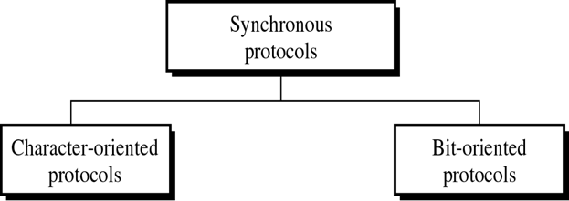
CS601-Data Communication
VU
LECTURE #40
YMODEM
YMODEM is similar to X-MODEM with only the following major differences:
1024-Byte data unit
Two CANs to abort Transmission
ITU-T CRC-16 for Error Checking
Multiple files can be sent simultaneously
ZMODEM
•Newer Protocol
•Combines features of
XMODEM
and
YMODEM
BLAST
Blocked Asynchronous Transmission
More powerful than XMODEM
Full Duplex
Sliding Window Flow Control
Allows transfer of Data and Binary Files
KERMIT
Designed at Columbia University
Most Widely used Asynchronous Protocol
File Transfer protocol is similar in operation to XMODEM, with sender waiting for an NAK before it starts TX
Kermit allows the transmission of control characters as Text
Synchronous Protocols
Speed of synchronous TX makes it a better choice over Asynchronous T for LAN, MAN and WAN technology
Classes of Synchronous Protocols
Synchronous Protocols can be divided into two main classes:

Slide 24
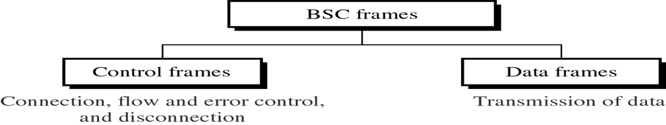
CS601-Data Communication
VU
Character – Oriented Protocols
Bit – Oriented Protocols
Character – Oriented Protocols
Also called Byte- Oriented Protocol
These protocols interpret a transmission frame or packet as a succession of characters, each usually composed of one byte
All control information is in the form of an existing character encoding system
Bit – Oriented Protocols
These protocols interpret a transmission frame or packet as a succession of individual bits, made meaningful by their placement in the frame
Control information can be one or multiple bits depending on the information embodied in the pattern
Character –Oriented Protocols are not as efficient as bit – oriented protocols and are seldom used
They are easy to comprehend and employ the same logic as bit-oriented protocols
Their study will provide the basis for studying the other data link layer protocols
In all data link protocols, control information is inserted in the data frame as separate control frames or as addition to existing data frames
In character oriented protocols, this info is in the form of code words taken from existing character sets such as ASCII
IBN’s BSC is the best known character oriented protocol
Binary Synchronous Communication (BSC)
Developed by IBM in 1964
Usable in both point-to-point and multiple communications
It supports half-duplex TX using stop-and-wait ARQ flow control
Does not support full duplex TX or sliding window protocol
BSC FRAMES
•BSC protocol divides a transmission into frames
CONTROL FRAMES
If a frame is used strictly for control purposes, it is called a Control frame
Control frames are used to exchange information b/w communicating devices for example, to establish the connection, to control the flow, to request error correction etc
DATA FRAMES

Slide 25
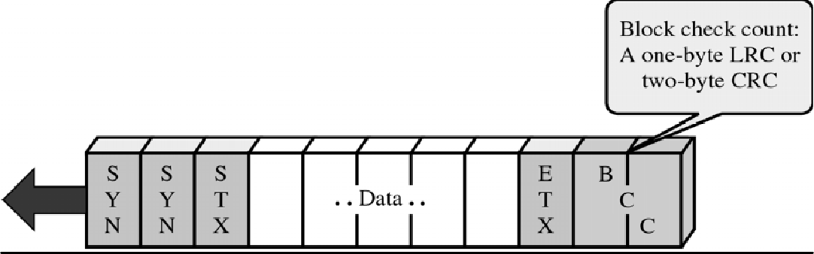
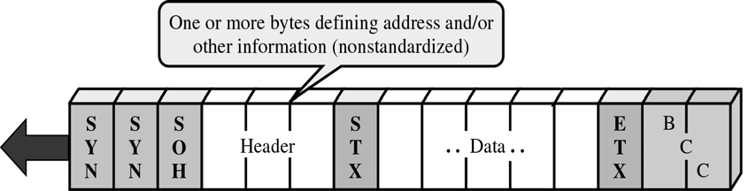
CS601-Data Communication VU
If a frame contains part or all of the message itself, it is called a Data Frame
Data frames are used to transmit information, but may also contain control information applicable to that information
Figure shows the format of a simple data frame
Arrow shows the direct of TX
The frame begins with two or more synch. (SYN) characters
These characters alert the receiver to the arrival of a new frame and provide a bit pattern used by the receiving device to synch itself with that of the sending device
After the two synch characters, comes a start of text (STX) character
This character signals to the receiver that the control information is ending and the next byte will be data
Data or text can consist of varying number of characters
An end of text (ETX) indicates the end of text
Finally, the Block Check Count (BCC) are included for error correction
A BCC field can be a one-character LRC or a two –character CRC
Data Frame with Header
•A frame as simple as above is seldom used
•Usually we need to include the address of the receiving device, the address of the sending device and the identity number of the frame (0 or 1) for stop-and-wait ARQ
All the above information is included in a special field called Header
Header begins with start of the header (SOH) character
The header comes after the SYNs and before the STX character
Everything received after the SOH field but before STX character is the Header information
Multiblock Frame

Slide 26
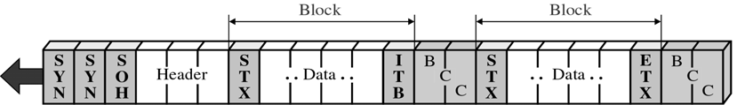
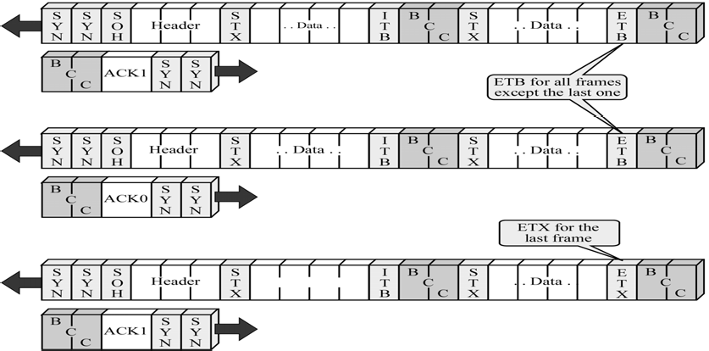
CS601-Data Communication
VU
The probability of an error in the block of text increases with the length of the frame
The more bits in a frame, the more are the chances of an error
For this reason, text in a message is often divided b/w several blocks
Each block starts with STX and ends with ITB, intermediate text block except the last one
Last block ends with ETX character
After the ETX has been reached, and the last BCC checked, the receiver sends a single ACK for the entire frame
The figure includes only 2 blocks but actual frames can have more than two
Some messages may be too long to fit in a frame
Several frames can carry continuation of a single message
To let the Rx know that the end of frame is not the end of transmission, the ETX character in all the frames but the last one is replaced by an End of Transmission block (ETB)
The receiver must acknowledge each frame separately
Multi Frames
Control Frames
A control frame is used by one device to send commands to or to get information from another device
A control frame contains control characters but no data
It carries information specific to the functioning of the data link layer itself

Slide 27
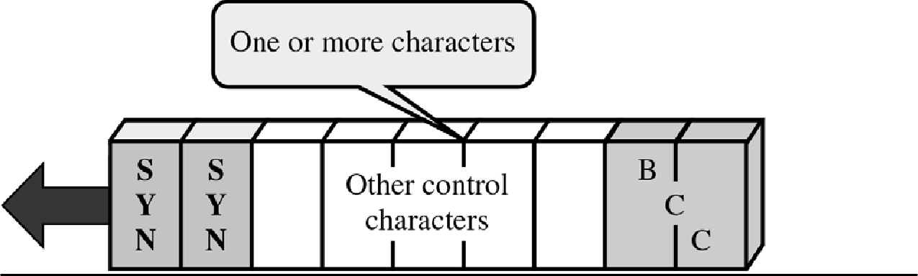
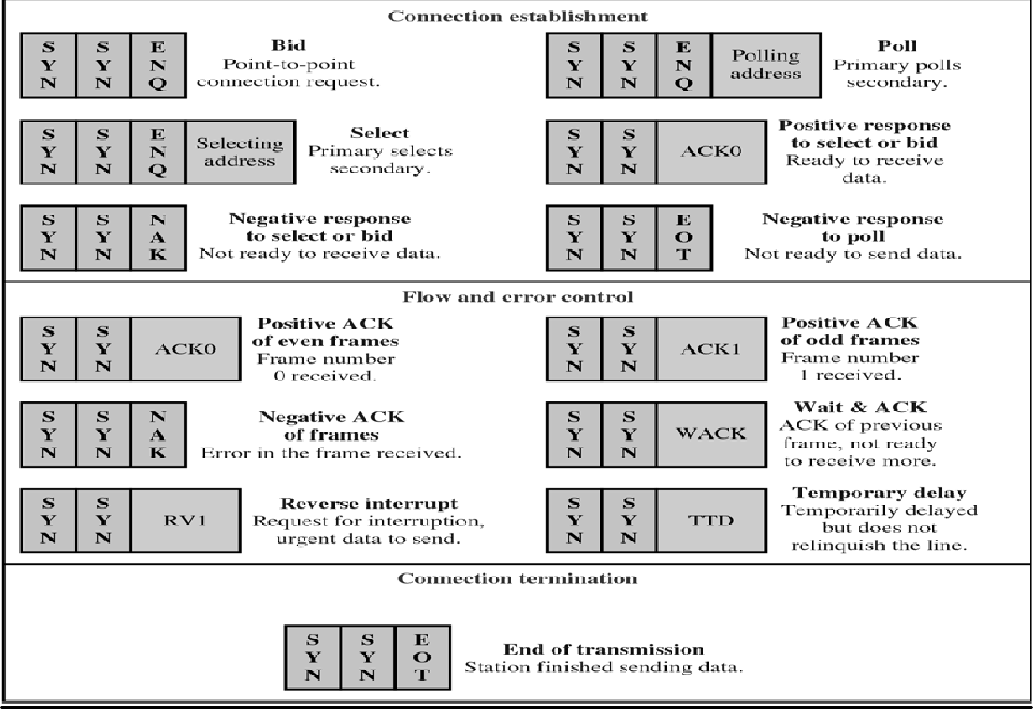
CS601-Data Communication
VU
Control frames serve 3 purposes:
Establishing Connections
Maintaining Flow and Error Control during Data Transmission
Terminating Connection
Summary
*Data Link Protocols
*Asynchronous Protocols
*Synchronous Protocols
Reading Sections
*Section11.1, 11.2
“Data Communications and Networking” 4th Edition by Behrouz A. Forouzan

